Slide 1

Chapter 4 Network Layer:
Data Plane
A note on the use of these PowerPoint slides:
We’re making these slides freely available to all (faculty, students, readers). They’re in PowerPoint form so you see the animations; and can add, modify, and delete slides (including this one) and slide content to suit your needs. They obviously represent a lot of work on our part. In return for use, we only ask the following:
If you use these slides (e.g., in a class) that you mention their source (after all, we’d like people to use our book!)
If you post any slides on a www site, that you note that they are adapted from (or perhaps identical to) our slides, and note our copyright of this material.
For a revision history, see the slide note for this page.
Thanks and enjoy! JFK/KWR
All material copyright 1996-2020
J.F Kurose and K.W. Ross, All Rights Reserved
Computer Networking: A Top-Down Approach 8th edition Jim Kurose, Keith Ross Pearson, 2020
Notes:
Version History
8.0 (May 2020)
All slides reformatted for 16:9 aspect ratio
All slides updated to 8th edition material
Use of Calibri font, rather that Gill Sans MT
Add LOTS more animation throughout
added new 8th edition material on middleboxes (and Internet arch), Net neutrality, buffering …
lighter header font
8.2 (July 2023), changes from 8.0:
some minor updates (e.g., IPv6 stats updated) but not much has changed.

Slide 2
Network layer: our goals
understand principles behind network layer services, focusing on data plane:
network layer service models
forwarding versus routing
how a router works
addressing
generalized forwarding
Internet architecture
instantiation, implementation in the Internet
IP protocol
NAT, middleboxes

Slide 3

Network layer: “data plane” roadmap
Network layer: overview
data plane
control plane
What’s inside a router
input ports, switching, output ports
buffer management, scheduling
IP: the Internet Protocol
datagram format
addressing
network address translation
IPv6
Generalized Forwarding, SDN
Match+action
OpenFlow: match+action in action
Middleboxes

Slide 4








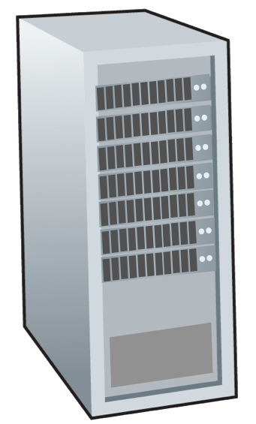







Network-layer services and protocols
transport segment from sending to receiving host
sender: encapsulates segments into datagrams, passes to link layer
receiver: delivers segments to transport layer protocol
network layer protocols in every Internet device: hosts, routers
routers:
examines header fields in all IP datagrams passing through it
moves datagrams from input ports to output ports to transfer datagrams along end-end path
mobile network
national or global ISP
application
transport
network
link
physical
network
link
physical
network
link
physical
network
link
physical
network
link
physical
network
link
physical
datacenter
network
application
transport
network
link
physical
enterprise
network

Slide 5
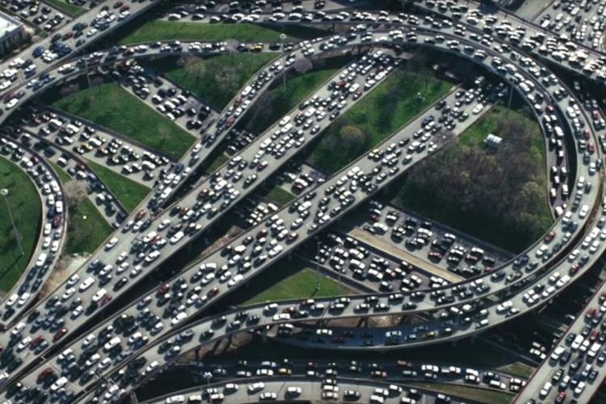
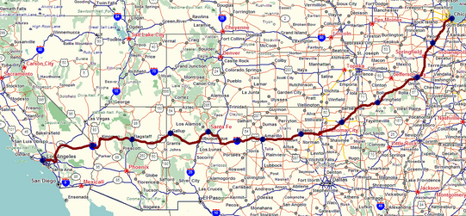
Two key network-layer functions
network-layer functions:
forwarding: move packets from a router’s input link to appropriate router output link
analogy: taking a trip
forwarding: process of getting through single interchange
routing: process of planning trip from source to destination
routing: determine route taken by packets from source to destination
routing algorithms
forwarding
routing

Slide 6
Network layer: data plane, control plane
Data plane:
local, per-router function
determines how datagram arriving on router input port is forwarded to router output port
Control plane
network-wide logic
determines how datagram is routed among routers along end-end path from source host to destination host
values in arriving
packet header
two control-plane approaches:
traditional routing algorithms: implemented in routers
software-defined networking (SDN): implemented in (remote) servers
0111
1
3
2

Slide 7

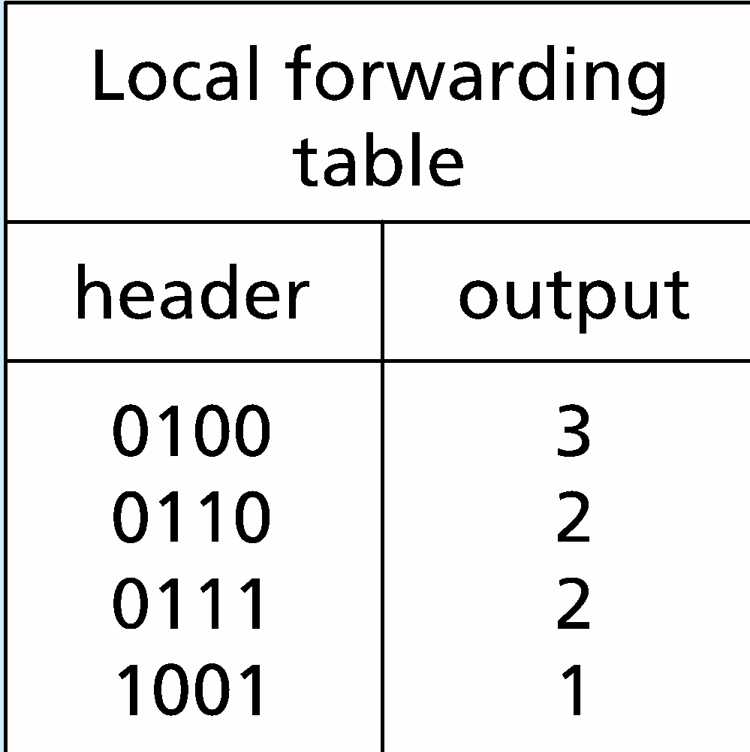
Per-router control plane
Individual routing algorithm components in each and every router interact in the control plane
Routing
Algorithm
control
plane
data
plane
values in arriving
packet header
0111
1
3
2

Slide 8
Software-Defined Networking (SDN) control plane
Remote controller computes, installs forwarding tables in routers
Remote Controller
control
plane
data
plane
CA
CA
CA
CA
CA
values in arriving
packet header
0111
1
3
2

Slide 9
Network service model
Q: What service model for “channel” transporting datagrams from sender to receiver?
example services for individual datagrams:
guaranteed delivery
guaranteed delivery with less than 40 msec delay
example services for a flow of datagrams:
in-order datagram delivery
guaranteed minimum bandwidth to flow
restrictions on changes in inter-packet spacing

Slide 10
Network-layer service model
Quality of Service (QoS) Guarantees ?
Network
Architecture
Internet
ATM
ATM
Internet
Internet
Service
Model
best effort
Constant Bit Rate
Available Bit Rate
Intserv Guaranteed
(RFC 1633)
Diffserv (RFC 2475)
Bandwidth
none
Constant rate
Guaranteed min
yes
possible
Loss
no
yes
no
yes
possibly
Order
no
yes
yes
yes
possibly
Timing
no
yes
no
yes
no
Internet “best effort” service model
No guarantees on:
successful datagram delivery to destination
timing or order of delivery
bandwidth available to end-end flow

Slide 11
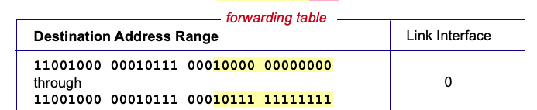

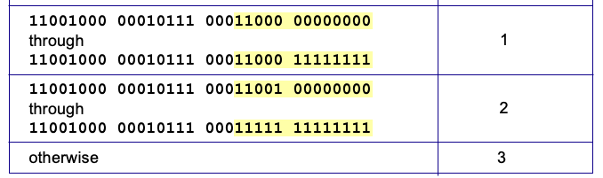
Destination-based forwarding
3
Q: but what happens if ranges don’t divide up so nicely?
Notes:
Text for this animation:
This all works out pretty nice and looks pretty simple!
But of course the devil is in the details, as the saying goes.
What happens, for example, when a subset of addresses say in this first range should go to say interface 3, rather than interface 0. Well, of course we could split the first address range into multiple pieces, and add in this new subrange with its new destination output port. But it turns out there’s a much simpler and elegant way to do this. Known as longest prefix matching.

Slide 12
Longest prefix matching
longest prefix match
when looking for forwarding table entry for given destination address, use longest address prefix that matches destination address.
Destination Address Range
11001000 00010111 00010
11001000 00010111 00011000
11001000 00010111 00011
otherwise
Link interface
0
1
2
3
***
********
********
***
********
examples:
11001000 00010111 00010110 10100001
which interface?
11001000 00010111 00011000 10101010
which interface?

Slide 13
Longest prefix matching
longest prefix match
when looking for forwarding table entry for given destination address, use longest address prefix that matches destination address.
Destination Address Range
11001000 00010111 00010
11001000 00010111 00011000
11001000 00010111 00011
otherwise
Link interface
0
1
2
3
***
********
********
match!
***
********
examples:
11001000 00010111 00010110 10100001
which interface?
11001000 00010111 00011000 10101010
which interface?

Slide 14
Longest prefix matching
longest prefix match
when looking for forwarding table entry for given destination address, use longest address prefix that matches destination address.
Destination Address Range
11001000 00010111 00010
11001000 00010111 00011000
11001000 00010111 00011
otherwise
Link interface
0
1
2
3
***
********
********
***
********
match!
examples:
11001000 00010111 00010110 10100001
which interface?
11001000 00010111 00011000 10101010
which interface?

Slide 15
Longest prefix matching
longest prefix match
when looking for forwarding table entry for given destination address, use longest address prefix that matches destination address.
Destination Address Range
11001000 00010111 00010
11001000 00010111 00011000
11001000 00010111 00011
otherwise
Link interface
0
1
2
3
***
********
********
***
********
match!
examples:
11001000 00010111 00010110 10100001
which interface?
11001000 00010111 00011000 10101010
which interface?

Slide 16
Packet Scheduling: FCFS
packet scheduling: deciding which packet to send next on link
first come, first served
priority
round robin
weighted fair queueing
FCFS: packets transmitted in order of arrival to output port
also known as: First-in-first-out (FIFO)
real world examples?
Abstraction: queue
R
packet
departures
packet
arrivals
queue
(waiting area)
link
(server)

Slide 17
Scheduling policies: priority
Priority scheduling:
arriving traffic classified, queued by class
any header fields can be used for classification
high priority queue
arrivals
classify
link
departures
low priority queue
2
send packet from highest priority queue that has buffered packets
FCFS within priority class
1
3
4
5
arrivals
packet in service
1
3
2
4
5
departures
1
3
2
4
5

Slide 18
Scheduling policies: round robin
Round Robin (RR) scheduling:
arriving traffic classified, queued by class
any header fields can be used for classification
server cyclically, repeatedly scans class queues, sending one complete packet from each class (if available) in turn
R
classify
arrivals
link
departures

Slide 19
Scheduling policies: weighted fair queueing
Weighted Fair Queuing (WFQ):
generalized Round Robin
each class, i, has weight, w_{i}, and gets weighted amount of service in each cycle:
w₁
w₂
R
w_{i}
Σ_{j}w_{j}
classify
arrivals
link
departures
w₃
minimum bandwidth guarantee (per-traffic-class)

Slide 20
Network layer: “data plane” roadmap
Network layer: overview
data plane
control plane
What’s inside a router
input ports, switching, output ports
buffer management, scheduling
IP: the Internet Protocol
datagram format
addressing
network address translation
IPv6
Generalized Forwarding, SDN
match+action
OpenFlow: match+action in action
Middleboxes

Slide 21
Network Layer: Internet
host, router network layer functions:
transport layer: TCP, UDP
IP protocol
datagram format
addressing
packet handling conventions
Path-selection algorithms: implemented in
routing protocols (OSPF, BGP)
SDN controller
network
layer
forwarding
table
ICMP protocol
error reporting
router “signaling”
link layer
physical layer

Slide 22
IP Datagram format
32 bits
IP protocol version number
head.
len
type of
service
total datagram
length (bytes)
ver
length
header length(bytes)
“type” of service:
diffserv (0:5)
ECN (6:7)
flgs
fragment
offset
fragmentation/
reassembly
16-bit identifier
time to
live
upper
layer
header
checksum
header checksum
TTL: remaining max hops
(decremented at each router)
source IP address
32-bit source IP address
destination IP address
Maximum length: 64K bytes
Typically: 1500 bytes or less
upper layer protocol (e.g., TCP or UDP)
32-bit destination IP address
overhead
options (if any)
e.g., timestamp, record route taken
20 bytes of TCP
20 bytes of IP
= 40 bytes + app layer overhead for TCP+IP
payload data
(variable length,
typically a TCP
or UDP segment)

Slide 23

IP addressing: introduction
223.1.1.1
IP address: 32-bit identifier associated with each host or router interface
interface: connection between host/router and physical link
router’s typically have multiple interfaces
host typically has one or two interfaces (e.g., wired Ethernet, wireless 802.11)
223.1.2.1
223.1.1.2
223.1.1.4
223.1.2.9
223.1.1.3
223.1.3.27
223.1.2.2
223.1.3.1
223.1.3.2
dotted-decimal IP address notation:
223.1.1.1 = 11011111 00000001 00000001 00000001
223
1
1
1

Slide 24
IP addressing: introduction
223.1.1.1
IP address: 32-bit identifier associated with each host or router interface
interface: connection between host/router and physical link
router’s typically have multiple interfaces
host typically has one or two interfaces (e.g., wired Ethernet, wireless 802.11)
223.1.2.1
223.1.1.2
223.1.1.4
223.1.2.9
223.1.1.3
223.1.3.27
223.1.2.2
223.1.3.1
223.1.3.2
dotted-decimal IP address notation:
223.1.1.1 = 11011111 00000001 00000001 00000001
223
1
1
1

Slide 25
IP addressing: introduction
223.1.1.1
Q: how are interfaces actually connected?
223.1.2.1
223.1.1.2
A: we’ll learn about that in chapters 6, 7
A: wired
Ethernet interfaces connected by Ethernet switches
223.1.1.4
223.1.2.9
223.1.1.3
223.1.3.27
223.1.2.2
223.1.3.1
223.1.3.2
For now: don’t need to worry about how one interface is connected to another (with no intervening router)
A: wireless WiFi interfaces connected by WiFi base station

Slide 26
Subnets
223.1.1.1
What’s a subnet ?
device interfaces that can physically reach each other without passing through an intervening router
223.1.2.1
223.1.1.2
223.1.1.4
223.1.2.9
223.1.1.3
223.1.3.27
223.1.2.2
IP addresses have structure:
subnet part: devices in same subnet have common high order bits
host part: remaining low order bits
223.1.3.1
223.1.3.2
network consisting of 3 subnets

Slide 27
Subnets
subnet 223.1.1.0/24
223.1.1.1
subnet 223.1.2.0/24
Recipe for defining subnets:
detach each interface from its host or router, creating “islands” of isolated networks
each isolated network is called a subnet
223.1.2.1
223.1.1.2
223.1.1.4
223.1.2.9
223.1.1.3
223.1.3.27
223.1.2.2
subnet
223.1.3.0/24
223.1.3.1
223.1.3.2
subnet mask: /24
(high-order 24 bits: subnet part of IP address)

Slide 28
Subnets
223.1.1.2
subnet 223.1.1/24
where are the subnets?
what are the /24 subnet addresses?
223.1.1.1
223.1.1.4
223.1.1.3
223.1.9.2
223.1.7.0
subnet 223.1.7/24
subnet 223.1.9/24
223.1.9.1
223.1.7.1
223.1.8.1
223.1.8.0
subnet 223.1.2/24
223.1.2.6
subnet 223.1.8/24
223.1.3.27
subnet 223.1.3/24
223.1.2.1
223.1.2.2
223.1.3.1
223.1.3.2

Slide 29
IP addressing: CIDR
CIDR: Classless InterDomain Routing (pronounced “cider”)
subnet portion of address of arbitrary length
address format: a.b.c.d/x, where x is # bits in subnet portion of address
subnet
part
host
part
11001000 00010111 00010000 00000000
200.23.16.0/23

Slide 30
IP addresses: how to get one?
That’s actually two questions:
Q: How does a host get IP address within its network (host part of address)?
Q: How does a network get IP address for itself (network part of address)
How does host get IP address?
hard-coded by sysadmin in config file (e.g., /etc/rc.config in UNIX)
DHCP: Dynamic Host Configuration Protocol: dynamically get address from as server
“plug-and-play”

Slide 31
DHCP: Dynamic Host Configuration Protocol
goal: host dynamically obtains IP address from network server when it “joins” network
can renew its lease on address in use
allows reuse of addresses (only hold address while connected/on)
support for mobile users who join/leave network
DHCP overview:
host broadcasts DHCP discover msg [optional]
DHCP server responds with DHCP offer msg [optional]
host requests IP address: DHCP request msg
DHCP server sends address: DHCP ack msg

Slide 32
DHCP client-server scenario
Typically, DHCP server will be co-located in router, serving all subnets to which router is attached
DHCP server
223.1.1.1
223.1.2.1
223.1.2.5
223.1.1.2
223.1.1.4
223.1.2.9
223.1.1.3
223.1.3.27
arriving DHCP client needs
address in this network
223.1.2.2
223.1.3.1
223.1.3.2

Slide 33


DHCP client-server scenario
DHCP server: 223.1.2.5
DHCP discover
Arriving client
src : 0.0.0.0, 68
dest.: 255.255.255.255,67
yiaddr: 0.0.0.0
transaction ID: 654
Broadcast: is there a DHCP server out there?
DHCP offer
src: 223.1.2.5, 67
dest: 255.255.255.255, 68
yiaddr: 223.1.2.4
transaction ID: 654
lifetime: 3600 secs
Broadcast: I’m a DHCP server! Here’s an IP address you can use
The two steps above can be skipped “if a client remembers and wishes to reuse a previously allocated network address” [RFC 2131]
DHCP request
src: 0.0.0.0, 68
dest:: 255.255.255.255, 67
yiaddr: 223.1.2.4
transaction ID: 655
lifetime: 3600 secs
Broadcast: OK. I would like to use this IP address!
DHCP ACK
src: 223.1.2.5, 67
dest: 255.255.255.255, 68
yiaddr: 223.1.2.4
transaction ID: 655
lifetime: 3600 secs
Broadcast: OK. You’ve got that IP address!

Slide 34
IP addresses: how to get one?
Q: how does network get subnet part of IP address?
A: gets allocated portion of its provider ISP’s address space
ISP's block 11001000 00010111 00010000 00000000 200.23.16.0/20
ISP can then allocate out its address space in 8 blocks:
Organization 0 11001000 00010111 00010000 00000000 200.23.16.0/23
Organization 1 11001000 00010111 00010010 00000000 200.23.18.0/23
Organization 2 11001000 00010111 00010100 00000000 200.23.20.0/23
... ….. …. ….
Organization 7 11001000 00010111 00011110 00000000 200.23.30.0/23

Slide 35
Hierarchical addressing: route aggregation
hierarchical addressing allows efficient advertisement of routing information:
Organization 0
200.23.16.0/23
Organization 1
200.23.18.0/23
“Send me anything
with addresses
beginning
200.23.16.0/20”
Organization 2
200.23.20.0/23
.
Fly-By-Night-ISP
.
.
.
.
Internet
Organization 7
.
200.23.30.0/23
ISPs-R-Us
“Send me anything
with addresses
beginning
199.31.0.0/16”

Slide 36
Hierarchical addressing: more specific routes
Organization 1 moves from Fly-By-Night-ISP to ISPs-R-Us
ISPs-R-Us now advertises a more specific route to Organization 1
Organization 0
200.23.16.0/23
Organization 1
200.23.18.0/23
“Send me anything
with addresses
beginning
200.23.16.0/20”
Organization 2
200.23.20.0/23
.
Fly-By-Night-ISP
.
.
.
.
Internet
Organization 7
.
200.23.30.0/23
ISPs-R-Us
“Send me anything
with addresses
beginning
199.31.0.0/16”
Organization 1
200.23.18.0/23
“or 200.23.18.0/23”

Slide 37
Hierarchical addressing: more specific routes
Organization 1 moves from Fly-By-Night-ISP to ISPs-R-Us
ISPs-R-Us now advertises a more specific route to Organization 1
Organization 0
200.23.16.0/23
“Send me anything
with addresses
beginning
200.23.16.0/20”
Organization 2
200.23.20.0/23
.
Fly-By-Night-ISP
.
.
.
.
Internet
Organization 7
.
200.23.30.0/23
ISPs-R-Us
“Send me anything
with addresses
beginning
199.31.0.0/16”
Organization 1
200.23.18.0/23
“or 200.23.18.0/23”

Slide 38
IP addressing: last words ...
Q: how does an ISP get block of addresses?
A: ICANN: Internet Corporation for Assigned Names and Numbers http://www.icann.org/
allocates IP addresses, through 5 regional registries (RRs) (who may then allocate to local registries)
manages DNS root zone, including delegation of individual TLD (.com, .edu , …) management
Q: are there enough 32-bit IP addresses?
ICANN allocated last chunk of IPv4 addresses to RRs in 2011
NAT (next) helps IPv4 address space exhaustion
IPv6 has 128-bit address space
"Who the hell knew how much address space we needed?" Vint Cerf (reflecting on decision to make IPv4 address 32 bits long)

Slide 39
Network layer: “data plane” roadmap
Network layer: overview
data plane
control plane
What’s inside a router
input ports, switching, output ports
buffer management, scheduling
IP: the Internet Protocol
datagram format
addressing
network address translation
IPv6
Generalized Forwarding, SDN
match+action
OpenFlow: match+action in action
Middleboxes

Slide 40
NAT: network address translation
NAT: all devices in local network share just one IPv4 address as far as outside world is concerned
rest of
Internet
local network (e.g., home network) 10.0.0/24
10.0.0.1
138.76.29.7
10.0.0.4
10.0.0.2
10.0.0.3
all datagrams leaving local network have same source NAT IP address: 138.76.29.7, but different source port numbers
datagrams with source or destination in this network have 10.0.0/24 address for source, destination (as usual)

Slide 41
NAT: network address translation
all devices in local network have 32-bit addresses in a “private” IP address space (10/8, 172.16/12, 192.168/16 prefixes) that can only be used in local network
advantages:
just one IP address needed from provider ISP for all devices
can change addresses of host in local network without notifying outside world
can change ISP without changing addresses of devices in local network
security: devices inside local net not directly addressable, visible by outside world

Slide 42
NAT: network address translation
implementation: NAT router must (transparently):
outgoing datagrams: replace (source IP address, port #) of every outgoing datagram to (NAT IP address, new port #)
remote clients/servers will respond using (NAT IP address, new port #) as destination address
remember (in NAT translation table) every (source IP address, port #) to (NAT IP address, new port #) translation pair
incoming datagrams: replace (NAT IP address, new port #) in destination fields of every incoming datagram with corresponding (source IP address, port #) stored in NAT table

Slide 43
NAT: network address translation
NAT translation table
WAN side addr LAN side addr
2: NAT router changes datagram source address from 10.0.0.1, 3345 to 138.76.29.7, 5001,
updates table
1: host 10.0.0.1 sends datagram to 128.119.40.186, 80
138.76.29.7, 5001 10.0.0.1, 3345
…… ……
S: 10.0.0.1, 3345
D: 128.119.40.186, 80
10.0.0.1
1
2
S: 138.76.29.7, 5001
D: 128.119.40.186, 80
10.0.0.4
10.0.0.2
138.76.29.7
S: 128.119.40.186, 80
D: 10.0.0.1, 3345
4
S: 128.119.40.186, 80
D: 138.76.29.7, 5001
3
10.0.0.3
3: reply arrives, destination address: 138.76.29.7, 5001

Slide 44
NAT: network address translation
NAT has been controversial:
routers “should” only process up to layer 3
address “shortage” should be solved by IPv6
violates end-to-end argument (port # manipulation by network-layer device)
NAT traversal: what if client wants to connect to server behind NAT?
but NAT is here to stay:
extensively used in home and institutional nets, 4G/5G cellular nets

Slide 45
IPv6: motivation
initial motivation: 32-bit IPv4 address space would be completely allocated
additional motivation:
speed processing/forwarding: 40-byte fixed length header
enable different network-layer treatment of “flows”

Slide 46
IPv6 datagram format
flow label: identify datagrams in same "flow.” (concept of “flow” not well defined).
32 bits
priority: identify priority among datagrams in flow
ver
pri
flow label
payload len
next hdr
hop limit
source address
(128 bits)
128-bit
IPv6 addresses
destination address
(128 bits)
payload (data)
What’s missing (compared with IPv4):
no checksum (to speed processing at routers)
no fragmentation/reassembly
no options (available as upper-layer, next-header protocol at router)

Slide 47
Transition from IPv4 to IPv6
not all routers can be upgraded simultaneously
no “flag days”
how will network operate with mixed IPv4 and IPv6 routers?
tunneling: IPv6 datagram carried as payload in IPv4 datagram among IPv4 routers (“packet within a packet”)
tunneling used extensively in other contexts (4G/5G)
IPv4 header fields
IPv6 header fields
IPv4 payload
IPv4 source, dest addr
IPv6 source dest addr
UDP/TCP payload
IPv6 datagram
IPv4 datagram

Slide 48
Tunneling and encapsulation
Ethernet connecting two IPv6 routers:
A
B
Ethernet connects two IPv6 routers
E
F
IPv6
IPv6
IPv6
IPv6
IPv6 datagram
Link-layer frame
The usual: datagram as payload in link-layer frame
IPv4 network connecting two IPv6 routers
A
B
E
F
IPv6
IPv6/v4
IPv6/v4
IPv6
IPv4 network

Slide 49
Tunneling and encapsulation
Ethernet connecting two IPv6 routers:
A
B
Ethernet connects two IPv6 routers
E
F
IPv6
IPv6
IPv6
IPv6
IPv6 datagram
Link-layer frame
The usual: datagram as payload in link-layer frame
IPv4 tunnel connecting two IPv6 routers
A
B
IPv4 tunnel
connecting IPv6 routers
E
F
IPv6
IPv6/v4
IPv6/v4
IPv6
IPv6 datagram
IPv4 datagram
tunneling: IPv6 datagram as payload in a IPv4 datagram

Slide 50
Tunneling
A
B
IPv4 tunnel
connecting IPv6 routers
E
F
logical view:
IPv6
IPv6/v4
IPv6/v4
IPv6
A
B
C
D
E
F
physical view:
IPv6
IPv6/v4
IPv4
IPv4
IPv6/v4
IPv6
flow: X
src: A
dest: F
data
src:B
dest: E
src:B
dest: E
src:B
dest: E
flow: X
src: A
dest: F
data
Flow: X
Src: A
Dest: F
data
Flow: X
Src: A
Dest: F
data
Flow: X
Src: A
Dest: F
data
Note source and destination addresses!
A-to-B:
IPv6
B-to-C:
IPv6 inside
IPv4
B-to-C:
IPv6 inside
IPv4
B-to-C:
IPv6 inside
IPv4
E-to-F:
IPv6

Slide 51
Network layer: “data plane” roadmap
Network layer: overview
data plane
control plane
What’s inside a router
input ports, switching, output ports
buffer management, scheduling
IP: the Internet Protocol
datagram format
addressing
network address translation
IPv6
Generalized Forwarding, SDN
Match+action
OpenFlow: match+action in action
Middleboxes

Slide 52
Generalized forwarding: match plus action
Review: each router contains a forwarding table
“match plus action” abstraction: match bits in arriving packet, take action
(aka: flow table)
destination-based forwarding: forward based on dest. IP address
values in arriving
packet header
generalized forwarding:
many header fields can determine action
many action possible: drop/copy/modify/log packet
0111
1
3
2
forwarding table
(aka: flow table)

Slide 53
Flow table abstraction
flow: defined by header field values (in link-, network-, transport-layer fields)
generalized forwarding: simple packet-handling rules
match: pattern values in packet header fields
actions: for matched packet: drop, forward, modify, matched packet or send matched packet to controller
priority: disambiguate overlapping patterns
counters: #bytes and #packets
Flow table
Router’s flow table define router’s match+action rules
match
action

Slide 54
Flow table abstraction
flow: defined by header fields
generalized forwarding: simple packet-handling rules
match: pattern values in packet header fields
actions: for matched packet: drop, forward, modify, matched packet or send matched packet to controller
priority: disambiguate overlapping patterns
counters: #bytes and #packets
src = *.*.*.*, dest=3.4.*.* forward(2)
Flow table
match
action
src=1.2.*.*, dest=*.*.*.* drop
src=10.1.2.3, dest=*.*.*.* send to controller
* : wildcard
1
4
3
2

Slide 55
OpenFlow: flow table entries
Match
Action
Stats
Packet + byte counters
Forward packet to port(s)
Drop packet
Modify fields in header(s)
Encapsulate and forward to controller
Header fields to match:
Ingress Port
Src MAC
Dst MAC
Eth Type
VLAN
ID
VLAN
Pri
IP Src
IP Dst
IP Proto
IP
ToS
TCP/UDP Src Port
TCP/UDP Dst Port
Link layer
Network layer
Transport layer

Slide 56
OpenFlow: examples
Destination-based forwarding:
Switch
Port
MAC
src
MAC
dst
Eth
type
VLAN
ID
VLAN
Pri
IP
Src
IP
Dst
IP
Prot
IP
ToS
TCP
s-port
TCP
d-port
Action
*
*
*
*
*
*
*
51.6.0.8
*
*
*
*
port6
IP datagrams destined to IP address 51.6.0.8 should be forwarded to router output port 6
Firewall:
Switch
Port
MAC
src
MAC
dst
Eth
type
VLAN
ID
VLAN
Pri
IP
Src
IP
Dst
IP
Prot
IP
ToS
TCP
s-port
TCP
d-port
Action
*
*
*
*
*
*
*
*
*
*
*
22
drop
Block (do not forward) all datagrams destined to TCP port 22 (ssh port #)
Switch
Port
MAC
src
MAC
dst
Eth
type
VLAN
ID
VLAN
Pri
IP
Src
IP
Dst
IP
Prot
IP
ToS
TCP
s-port
TCP
d-port
Action
*
*
*
*
*
*
128.119.1.1
*
*
*
*
*
drop
Block (do not forward) all datagrams sent by host 128.119.1.1

Slide 57
OpenFlow: examples
Layer 2 destination-based forwarding:
Switch
Port
MAC
src
MAC
dst
Eth
type
VLAN
ID
VLAN
Pri
IP
Src
IP
Dst
IP
Prot
IP
ToS
TCP
s-port
TCP
d-port
Action
*
*
22:A7:23:
11:E1:02
*
*
*
*
*
*
*
*
*
port3
layer 2 frames with destination MAC address 22:A7:23:11:E1:02 should be forwarded to output port 3

Slide 58
OpenFlow abstraction
match+action: abstraction unifies different kinds of devices
Router
match: longest destination IP prefix
action: forward out a link
Switch
match: destination MAC address
action: forward or flood
Firewall
match: IP addresses and TCP/UDP port numbers
action: permit or deny
NAT
match: IP address and port
action: rewrite address and port

Slide 59


OpenFlow example
Orchestrated tables can create network-wide behavior, e.g.,:
datagrams from hosts h5 and h6 should be sent to h3 or h4, via s1 and from there to s2
Host h6
10.3.0.6
1
s3
controller
2
3
4
Host h5
10.3.0.5
1
s1
s2
Host h1
10.1.0.1
1
2
Host h4
10.2.0.4
4
2
4
3
3
Host h2
10.1.0.2
Host h3
10.2.0.3

Slide 60
OpenFlow example
match
action
Orchestrated tables can create network-wide behavior, e.g.,:
datagrams from hosts h5 and h6 should be sent to h3 or h4, via s1 and from there to s2
IP Src = 10.3.*.*
IP Dst = 10.2.*.*
Host h6
10.3.0.6
forward(3)
1
s3
controller
2
3
4
Host h5
10.3.0.5
1
s1
s2
Host h1
10.1.0.1
1
2
Host h4
10.2.0.4
4
2
4
3
3
match
action
match
action
Host h2
10.1.0.2
Host h3
10.2.0.3
ingress port = 2
IP Dst = 10.2.0.3
ingress port = 2
IP Dst = 10.2.0.4
ingress port = 1
IP Src = 10.3.*.*
IP Dst = 10.2.*.*
forward(3)
forward(4)
forward(4)

Slide 61
Generalized forwarding: summary
“match plus action” abstraction: match bits in arriving packet header(s) in any layers, take action
matching over many fields (link-, network-, transport-layer)
local actions: drop, forward, modify, or send matched packet to controller
“program” network-wide behaviors
simple form of “network programmability”
programmable, per-packet “processing”
historical roots: active networking
today: more generalized programming:
P4 (see p4.org).

Slide 62
IP fragmentation/reassembly
network links have MTU (max. transfer size) - largest possible link-level frame
different link types, different MTUs
large IP datagram divided (“fragmented”) within net
one datagram becomes several datagrams
“reassembled” only at destination
IP header bits used to identify, order related fragments
…
fragmentation:
in: one large datagram
out: 3 smaller datagrams
reassembly
…

Slide 63
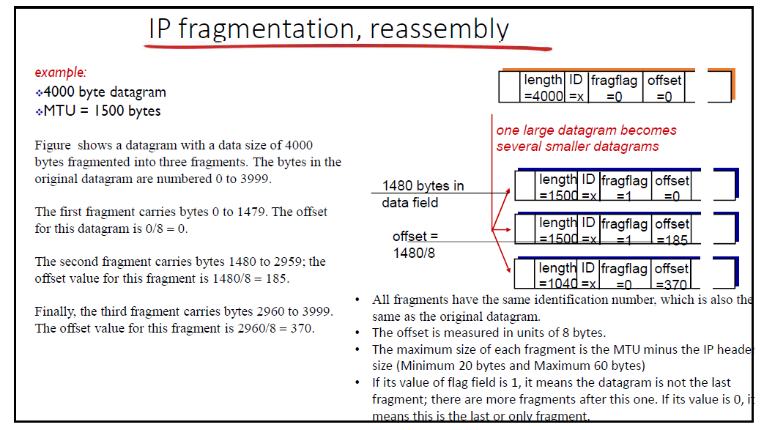

Slide 64
IP fragmentation/reassembly
example:
4000 byte datagram
MTU = 1500 bytes
length
=4000
ID
=x
fragflag
=0
offset
=0
one large datagram becomes
several smaller datagrams
1480 bytes in data field
length
=1500
ID
=x
fragflag
=1
offset
=0
offset =
1480/8
length
=1500
ID
=x
fragflag
=1
offset
=185
length
=1040
ID
=x
fragflag
=0
offset
=370

Slide 65
